Slide 1
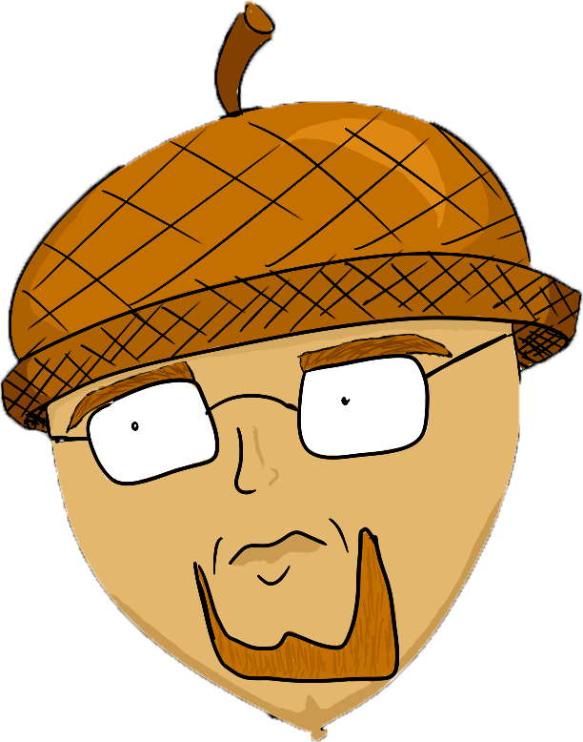
Mr. Adelmund
My year in review

Slide 2
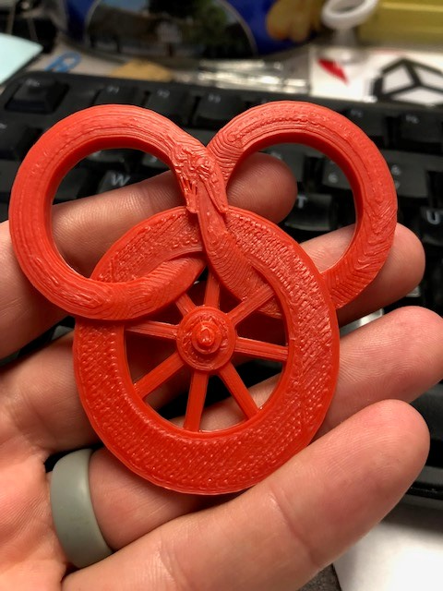
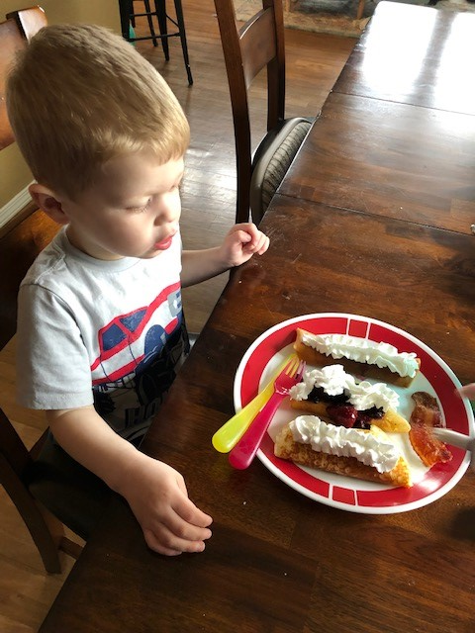
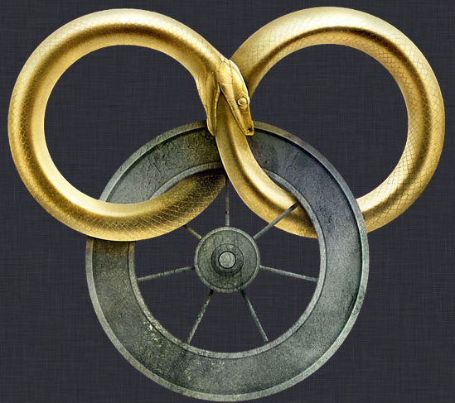
About Me
Love to read, cook, play Magic
3 year old son
Married 10 years
Math degree from UW
5 years at PNNL
Fourth year teaching

Slide 3
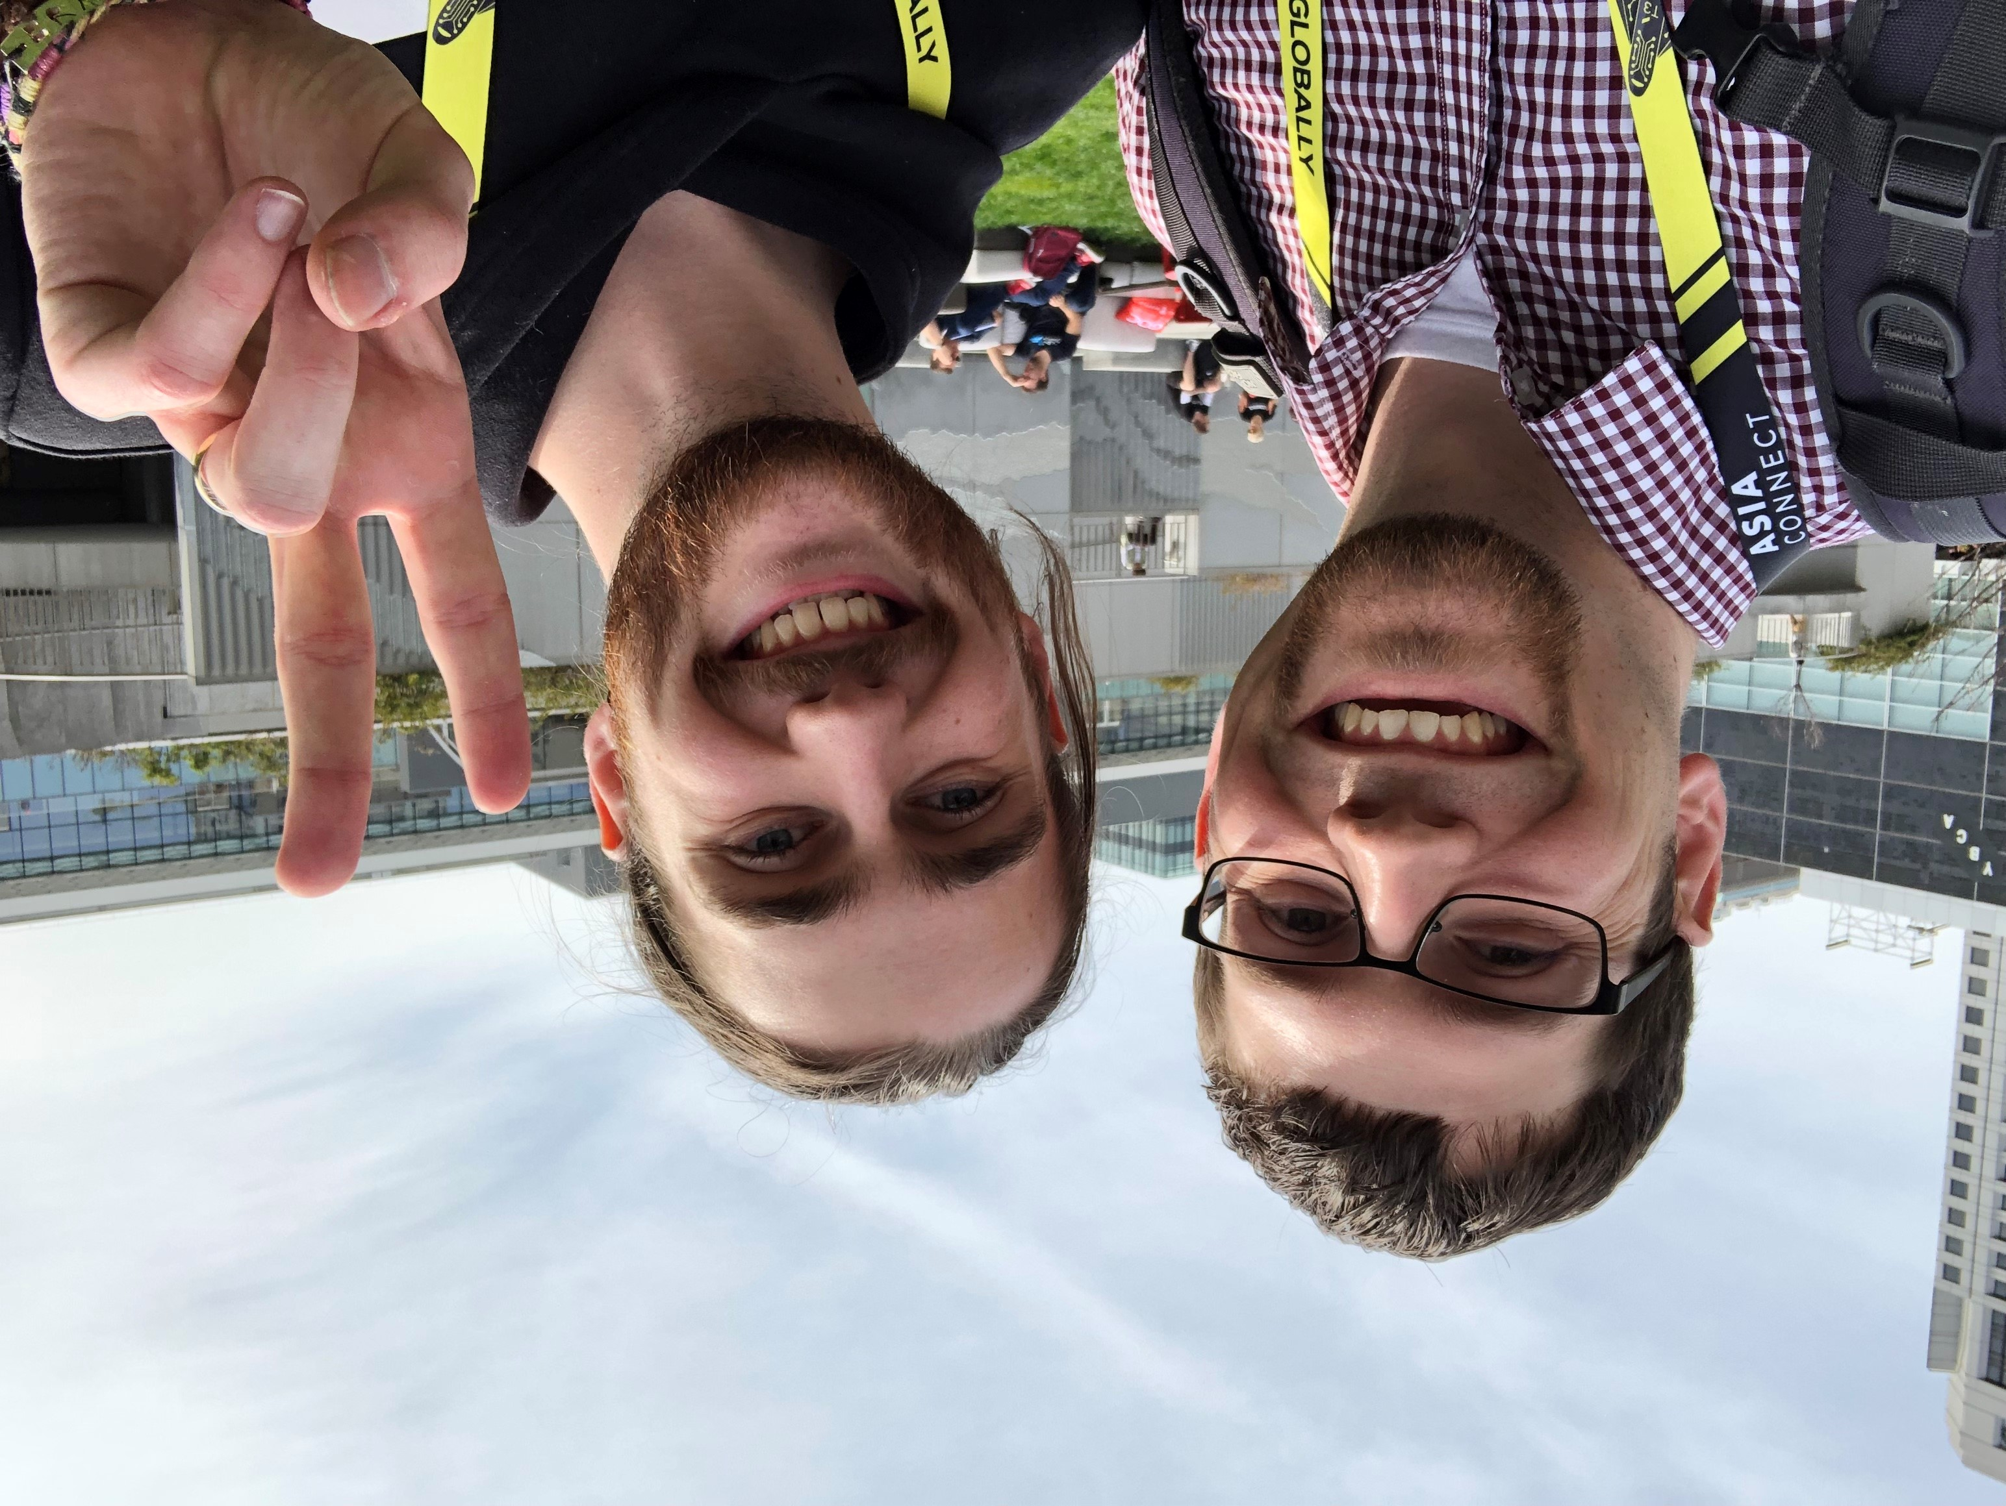
Successes
Second-year App Challenge submissions
New computers
Blender/art
Github
Share drive organization
Curriculum organization
GDC
Site council

Slide 4
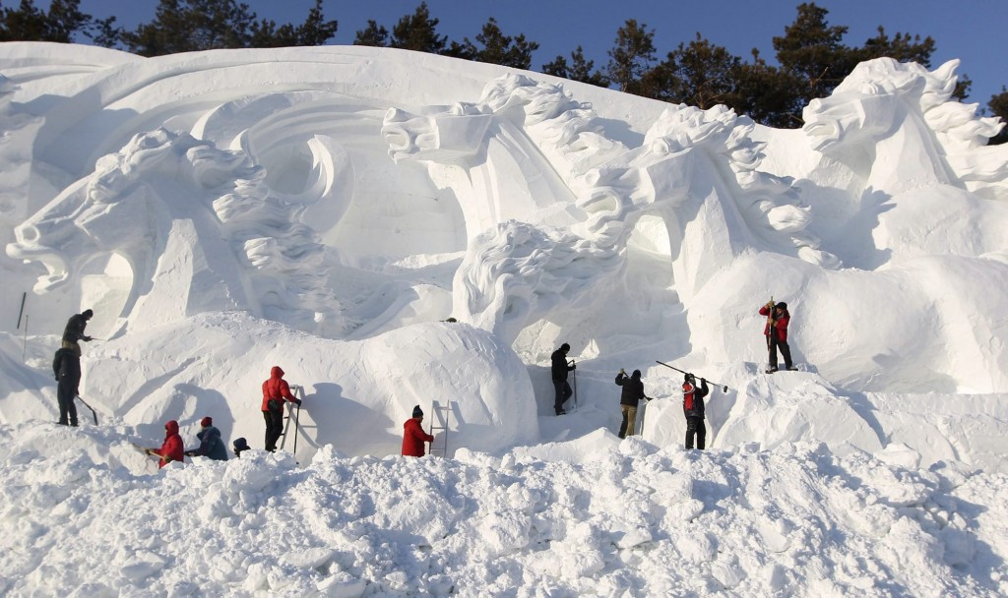
Challenges
Communication with parents
Masters program
Organization
Snow day disruptions
Field trips
New computers

Slide 5
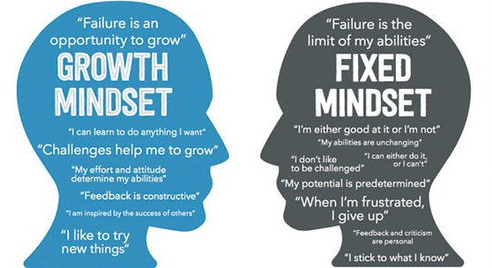
Personal Satisfaction
Very good year
Growth mindset
Personal growth
Learning from students
Admitting I don’t know

Slide 6

Career Plans
Masters completed by September
+90 credits completed by 2020 school year
Continue teaching
GDC
Game development

Slide 7
Tri-Tech Advantages/Disadvantages
Advantages:
Learn job skills
Employability
Follow your interests
Long periods
Meet people with similar interests
Disadvantages:
Weird schedules
Bus schedules
Not as much time with other friends
Lunch
Tour days

Slide 8
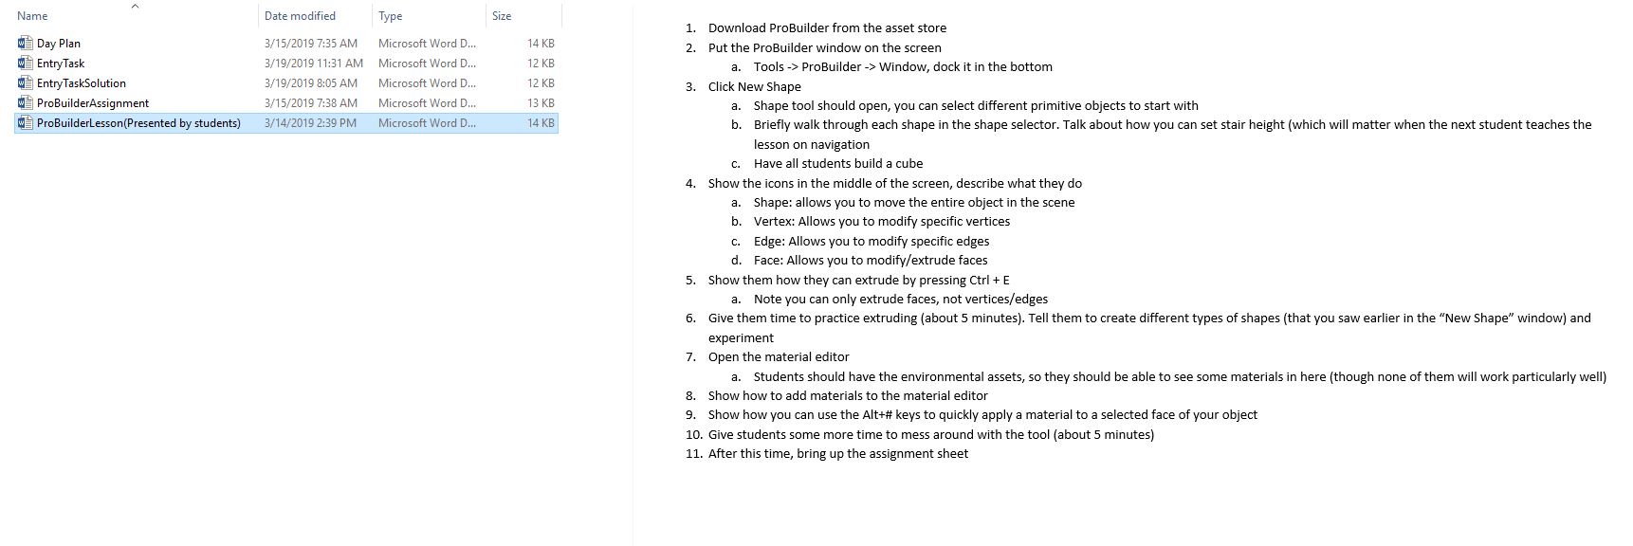
Work Examples

Slide 9
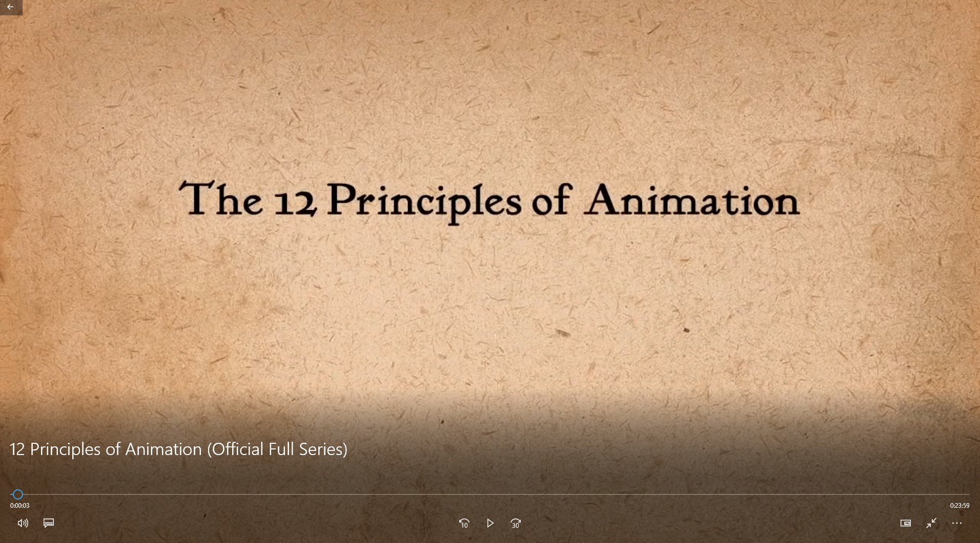
Work Examples

Slide 10
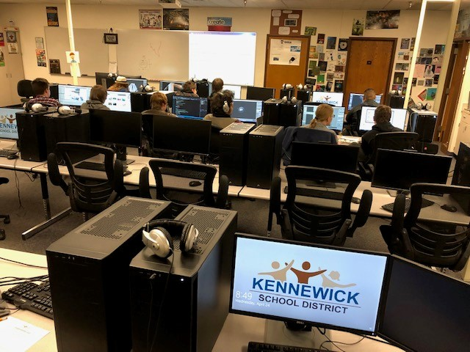
Work Examples

Slide 11
Work Examples

Slide 12
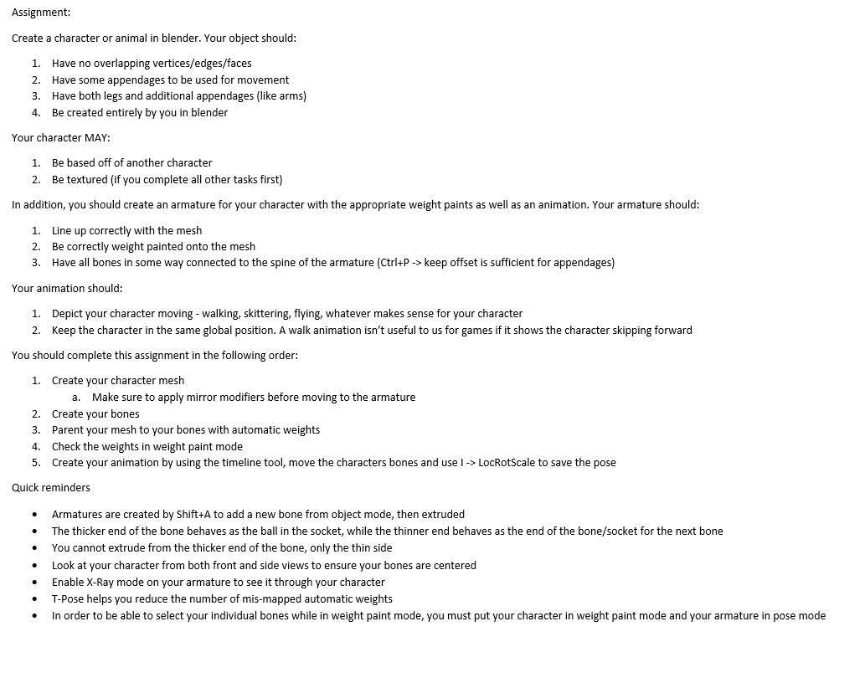
Work Examples

Slide 13
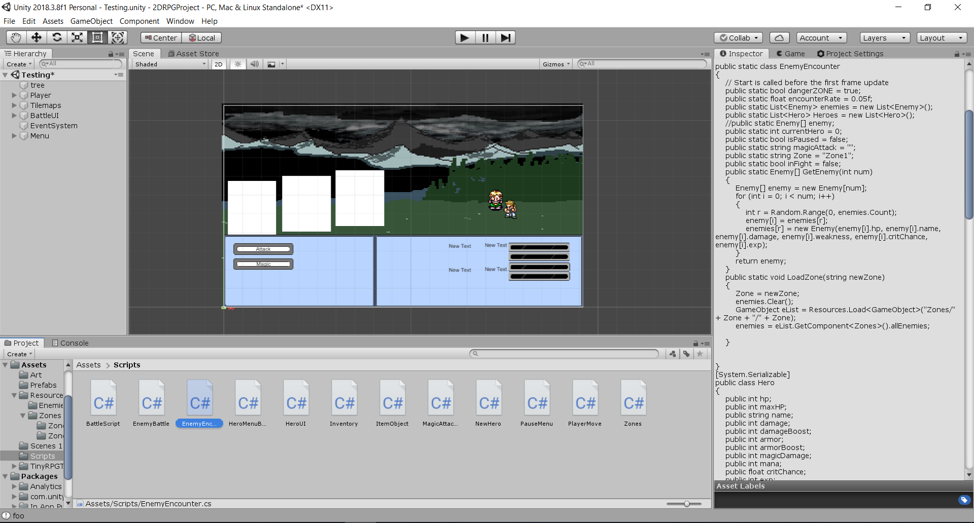
Work Examples

